Slide 1
Rhetorical Analysis
How do you appeal to your audience?

Slide 2
What the Heck is Rhetorical Analysis?
In order to answer this question, we should start by defining the word rhetoric.
Google provides two definitions for the word.
RHETORIC 1: the art of effective or persuasive speaking or writing, especially the use of figures of speech and other compositional techniques
RHETORIC 2: language designed to have a persuasive or impressive effect on its audience, but often regarded as lacking in sincerity or meaningful content.

Slide 3
Okay, So…?
So, based on these definitions, RHETORICAL ANALYSIS means to analyze a piece of text, a given source, or an artifact (like an advertisement or a commercial).
When you do this, you examine the interactions between a text, an author, and his or her audience.

Slide 4
So, How Do I Do This?
In order to rhetorically analyze a text, you need to look at what are called RHETORICAL APPEALS. There are four of these, and they are used by authors of persuasive texts or artifacts (like advertisements and commercials) to draw the audience in (or buy the product!)

Slide 5
Rhetorical Appeal #1: Ethos
ETHOS is an appeal to credibility, authority, and ethics. This is how you can remember it. Ethos=Ethics.
Asks questions like “Why should I, the reader, read what this author has written?” and “How does the author convince me that he or she is a valid source of information?”

Slide 6
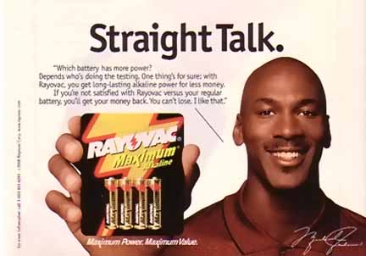
ETHOS

Slide 7
Rhetorical Appeal #2: Pathos
PATHOS is an appeal to the reader’s emotions. This can be an appeal to any emotion in the reader, like pity, sympathy, etc…
Asks questions like, “How is the author trying to make me feel?” or “What has he or she written that makes me want to take action?”
Hint: This is a very popular rhetorical appeal, especially with advertisements and commercials.

Slide 8
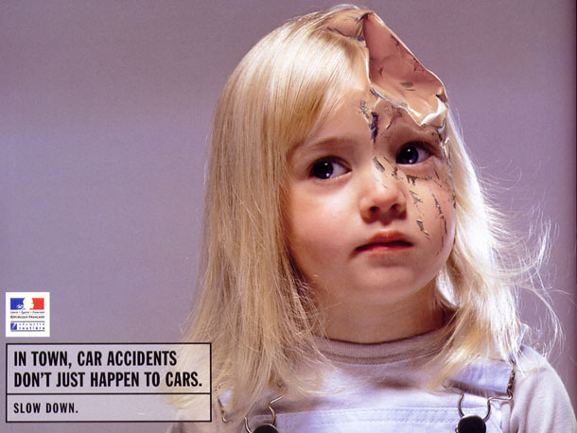
PATHOS

Slide 9
Rhetorical Appeal #3: Logos
Logos is an appeal to the reader’s logic. Hence, LOGOS. LOGOS=Logic.
In other words, the author is appealing to the reader’s voice that says, “this makes sense.”
Asks questions like, “What evidence has the author provided me that their argument makes sense?” and “What proof is the author offering me?”

Slide 10
LOGOS

Slide 11
Rhetorical Appeal #4: Kairos
Kairos has to do with the “timeliness” of an argument.
For an ad to be successful, it needs to appropriate tone and structure and to come at the right time.
For example, an ad with NSYNC in it would be more appropriate, and would reach a wider audience in the 1990’s than it would today. That’s kairos.
A Sears ad featuring Kim Kardashian would be more appropriate in Teen Vogue than in AARP magazine. That’s kairos.

Slide 12
So, In Review…
There are four main rhetorical appeals: ETHOS, PATHOS, LOGOS, and KAIROS
Ethos appeals to the reader’s sense of credibility or ethics.
Pathos appeals to the reader’s emotions
Logos appeals to the reader’s sense of logic.
Kairos appeals to the timeliness and appropriateness of the advertisement.
When you analyze a text, an advertisement, or a commercial, you may see ALL THREE types of appeals in that particular media, or you may see only one.

Slide 13
Review, Cntd…
Rhetorical appeals help an author better persuade his or her reader/watcher.
The following slides contain advertisements and/or commercials that we, as a class, will be analyzing for rhetorical appeals.

Slide 15
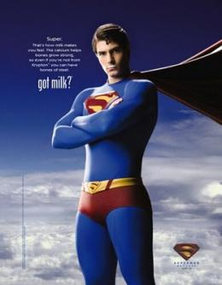

Slide 16
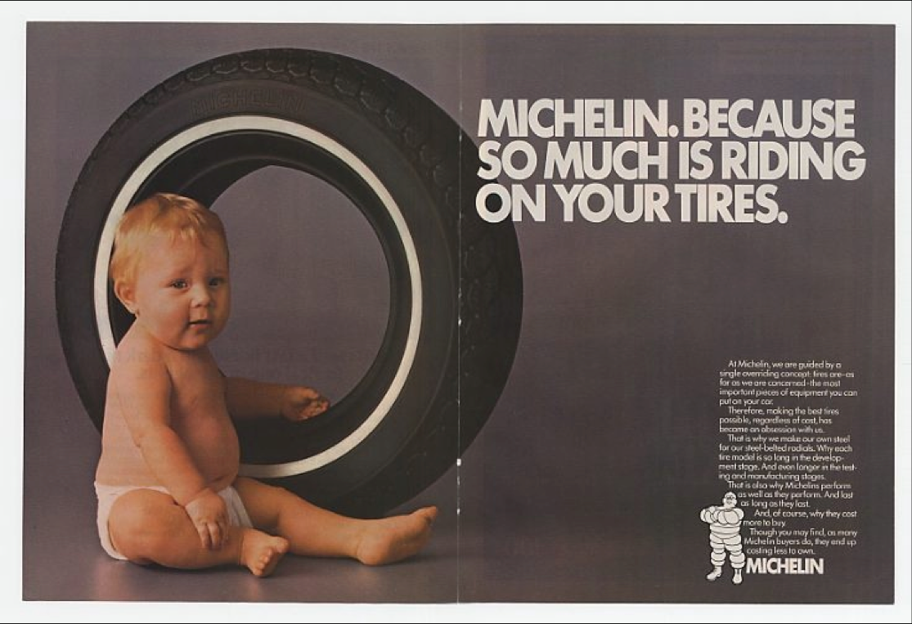

Slide 18
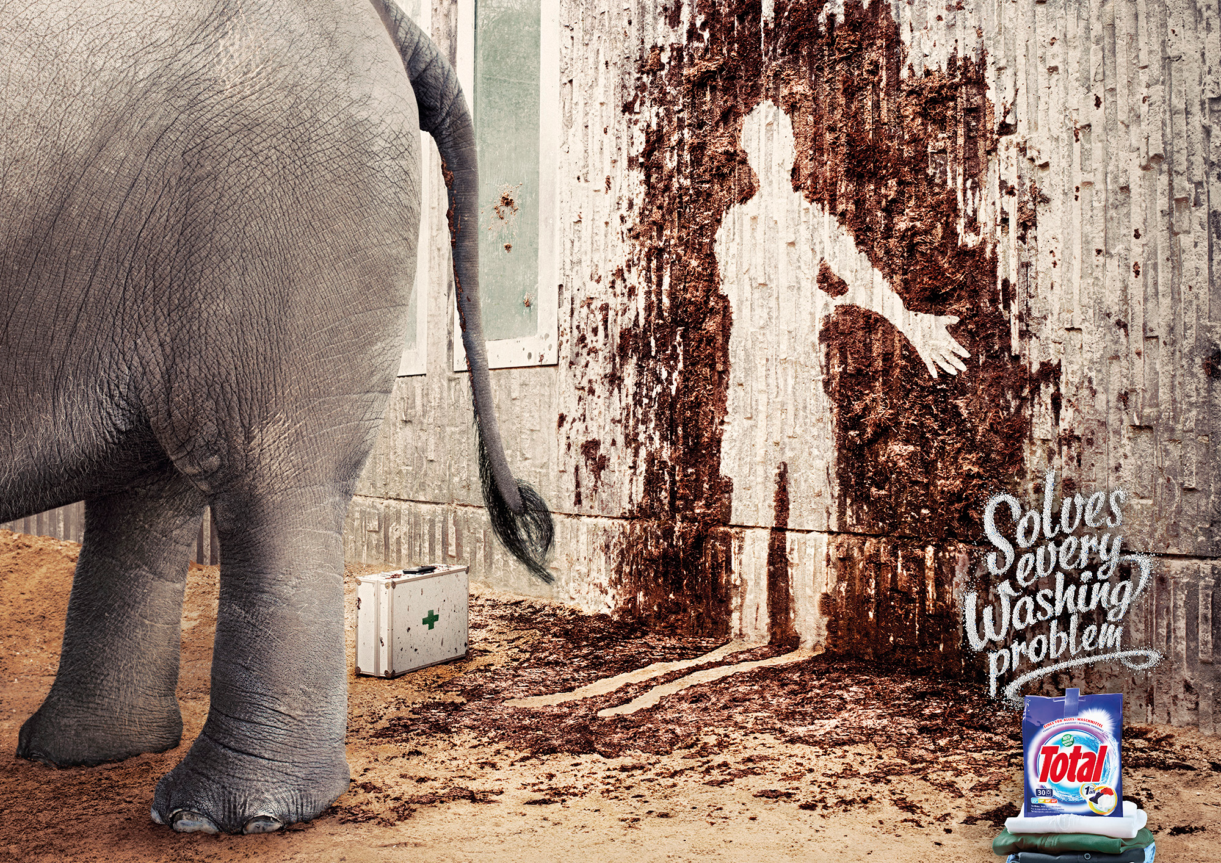

Slide 20
Commercials
Old Spice
Tips From a Former Smoker
Animal Abuse
GEICO

